Slide 1

Power Electronics
电力电子技术
Textbook
«Power electronics: converter, applications, and Design», 3rd edition.
Authors: N. Mohan, T. M. Undeland, W. P. Robbins.
Published by John Wiley & Sons, New York, 2003, Higher Education Press, Beijing, China, 2004

Slide 2

张立伟教授
Prof. Zhang Liwei
Website: http://faculty.bjtu.edu.cn/8134/
Office：D208, East Building of mechanical engineering building
E-mail：lwzhang@bjtu.edu.cn
Tel： 82335
Mobile:13552683918

Slide 3
Chapter 1：Power Electronic System
1-1 Introduction——电力电子技术的作用
1-2 Need for High Efficiency and High
Power Density——要求
1-3 Applications and the Role of Power
Electronics——应用
1-4 Classification of Power Processors
and Converters——分类
1-5 Interdisciplinary nature of power
electronics——性质
1-6 About the text
1-7 About the Course

Slide 4
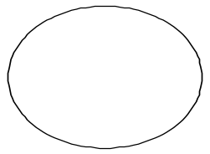
1-1 Introduction
(1) Block diagram----Typical power sources and loads for a power electronic system
Power input
Power
Converter
Power output
Load
Source
v_{i}
i_{i}
i_{o}
v_{o}
Feedback/
Feed forward
Fig. 1-1
Controller
Reference
-Electric Motor
-light
-heating
-power converter
-other electric or electronic equipment
-Electric utility
-battery
-other electric energy source
-power converter

Slide 5
(2) Role of Power Electronics ☆
Process and control the flow of electric energy by supplying voltages and current in a form that is optimally suited for user loads.
Power input
Power
Converter
Power output
Load
Source
v_{i}
i_{i}
i_{o}
v_{o}
Feedback/
Feed forward
Fig. 1-1
Controller
Reference

Slide 6
Power input
Power
Converter
Power output
Load
Source
v_{i}
i_{i}
i_{o}
v_{o}
Feedback/
Feed forward
Fig. 1-1
Controller
Reference
Providing the needed interface between the electrical source and the electrical load.
transferring of power: differing in frequency, voltage amplitudes and the number of phase.
Needed high energy efficiency and high power density

Slide 7
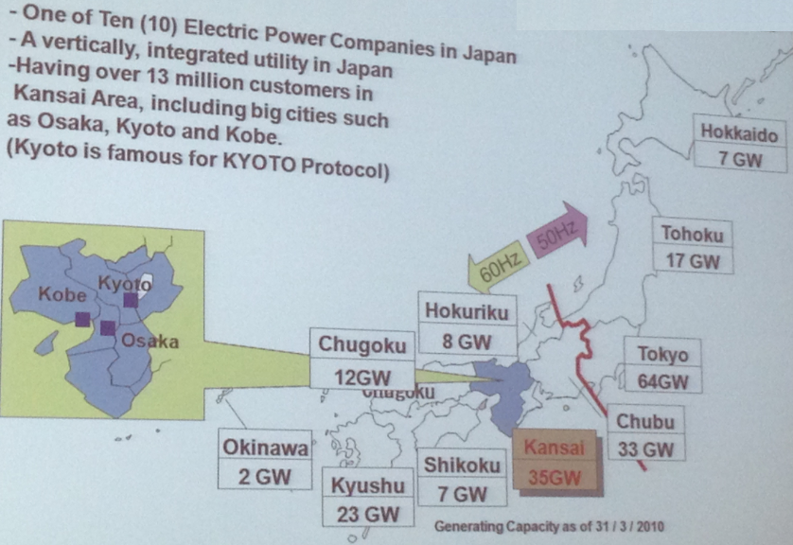

Slide 8
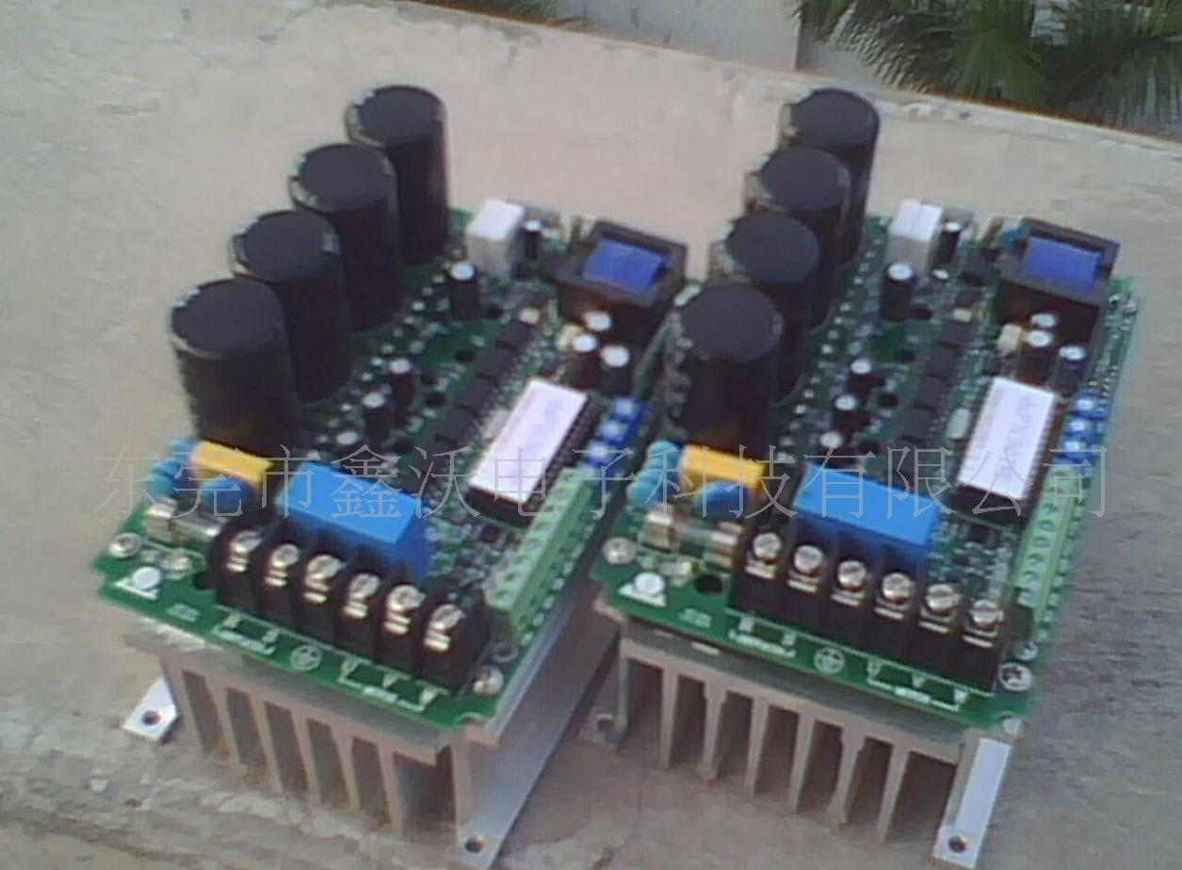
1-2 NEED FOR HIGH EFFICIENCY AND HIGH
POWER DENSITY
(1) High energy efficiency is important for several reasons:
Lowers operating costs by avoiding the cost of wasted energy.
Contributes less to global warming.
Reduces the need for cooling therefore increasing power density.

Slide 9
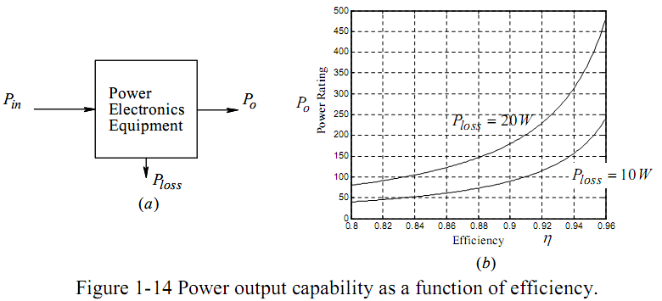

The relationship between the energy efficiency and power density

Slide 10
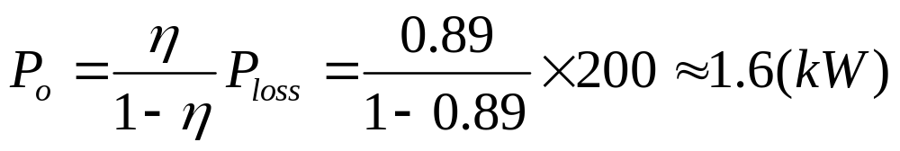
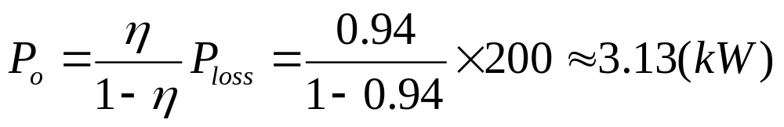
Example 1-1 A power electronics package is designed to handle 200W of power dissipation. Compare the two values of the output power capability if the conversion efficiency is increased from 89% to 94%.
Solution In this example, P_{loss}=200W
At η=89%,
At η=94%,

Slide 11
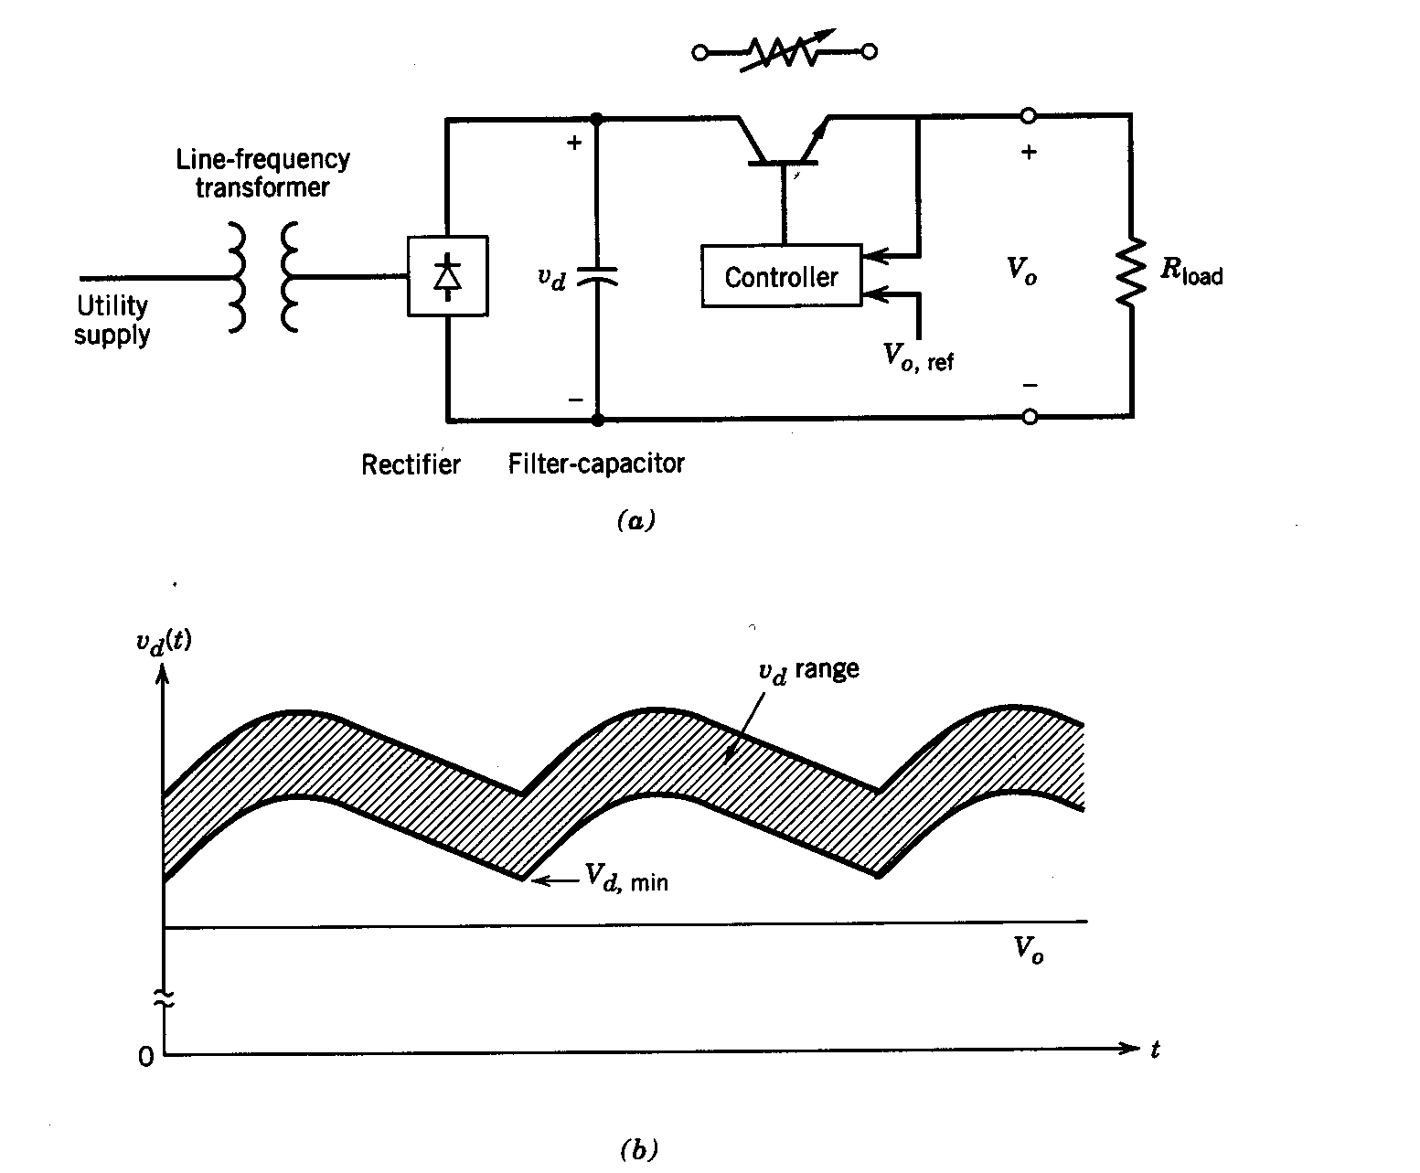
(2) Linear Power Supply
Series transistor as an adjustable resistor
Low Efficiency
Heavy and bulky
Fig. 1-2

Slide 12
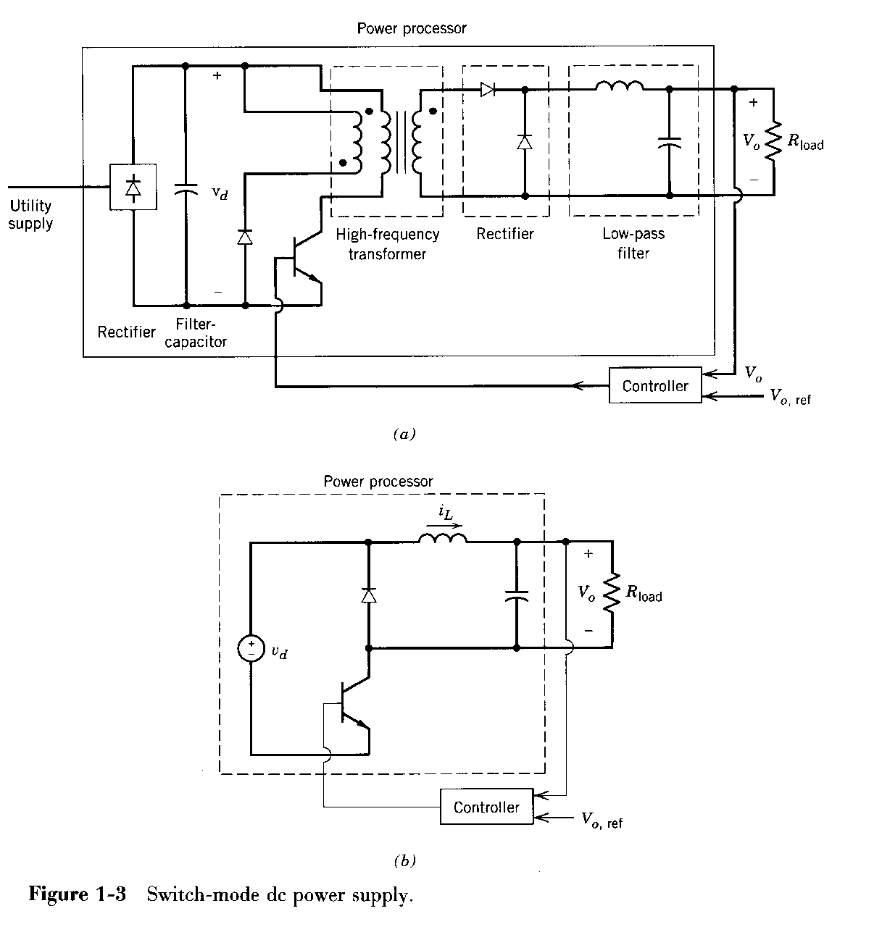
(3) Switch-Mode Power Supply

Slide 13
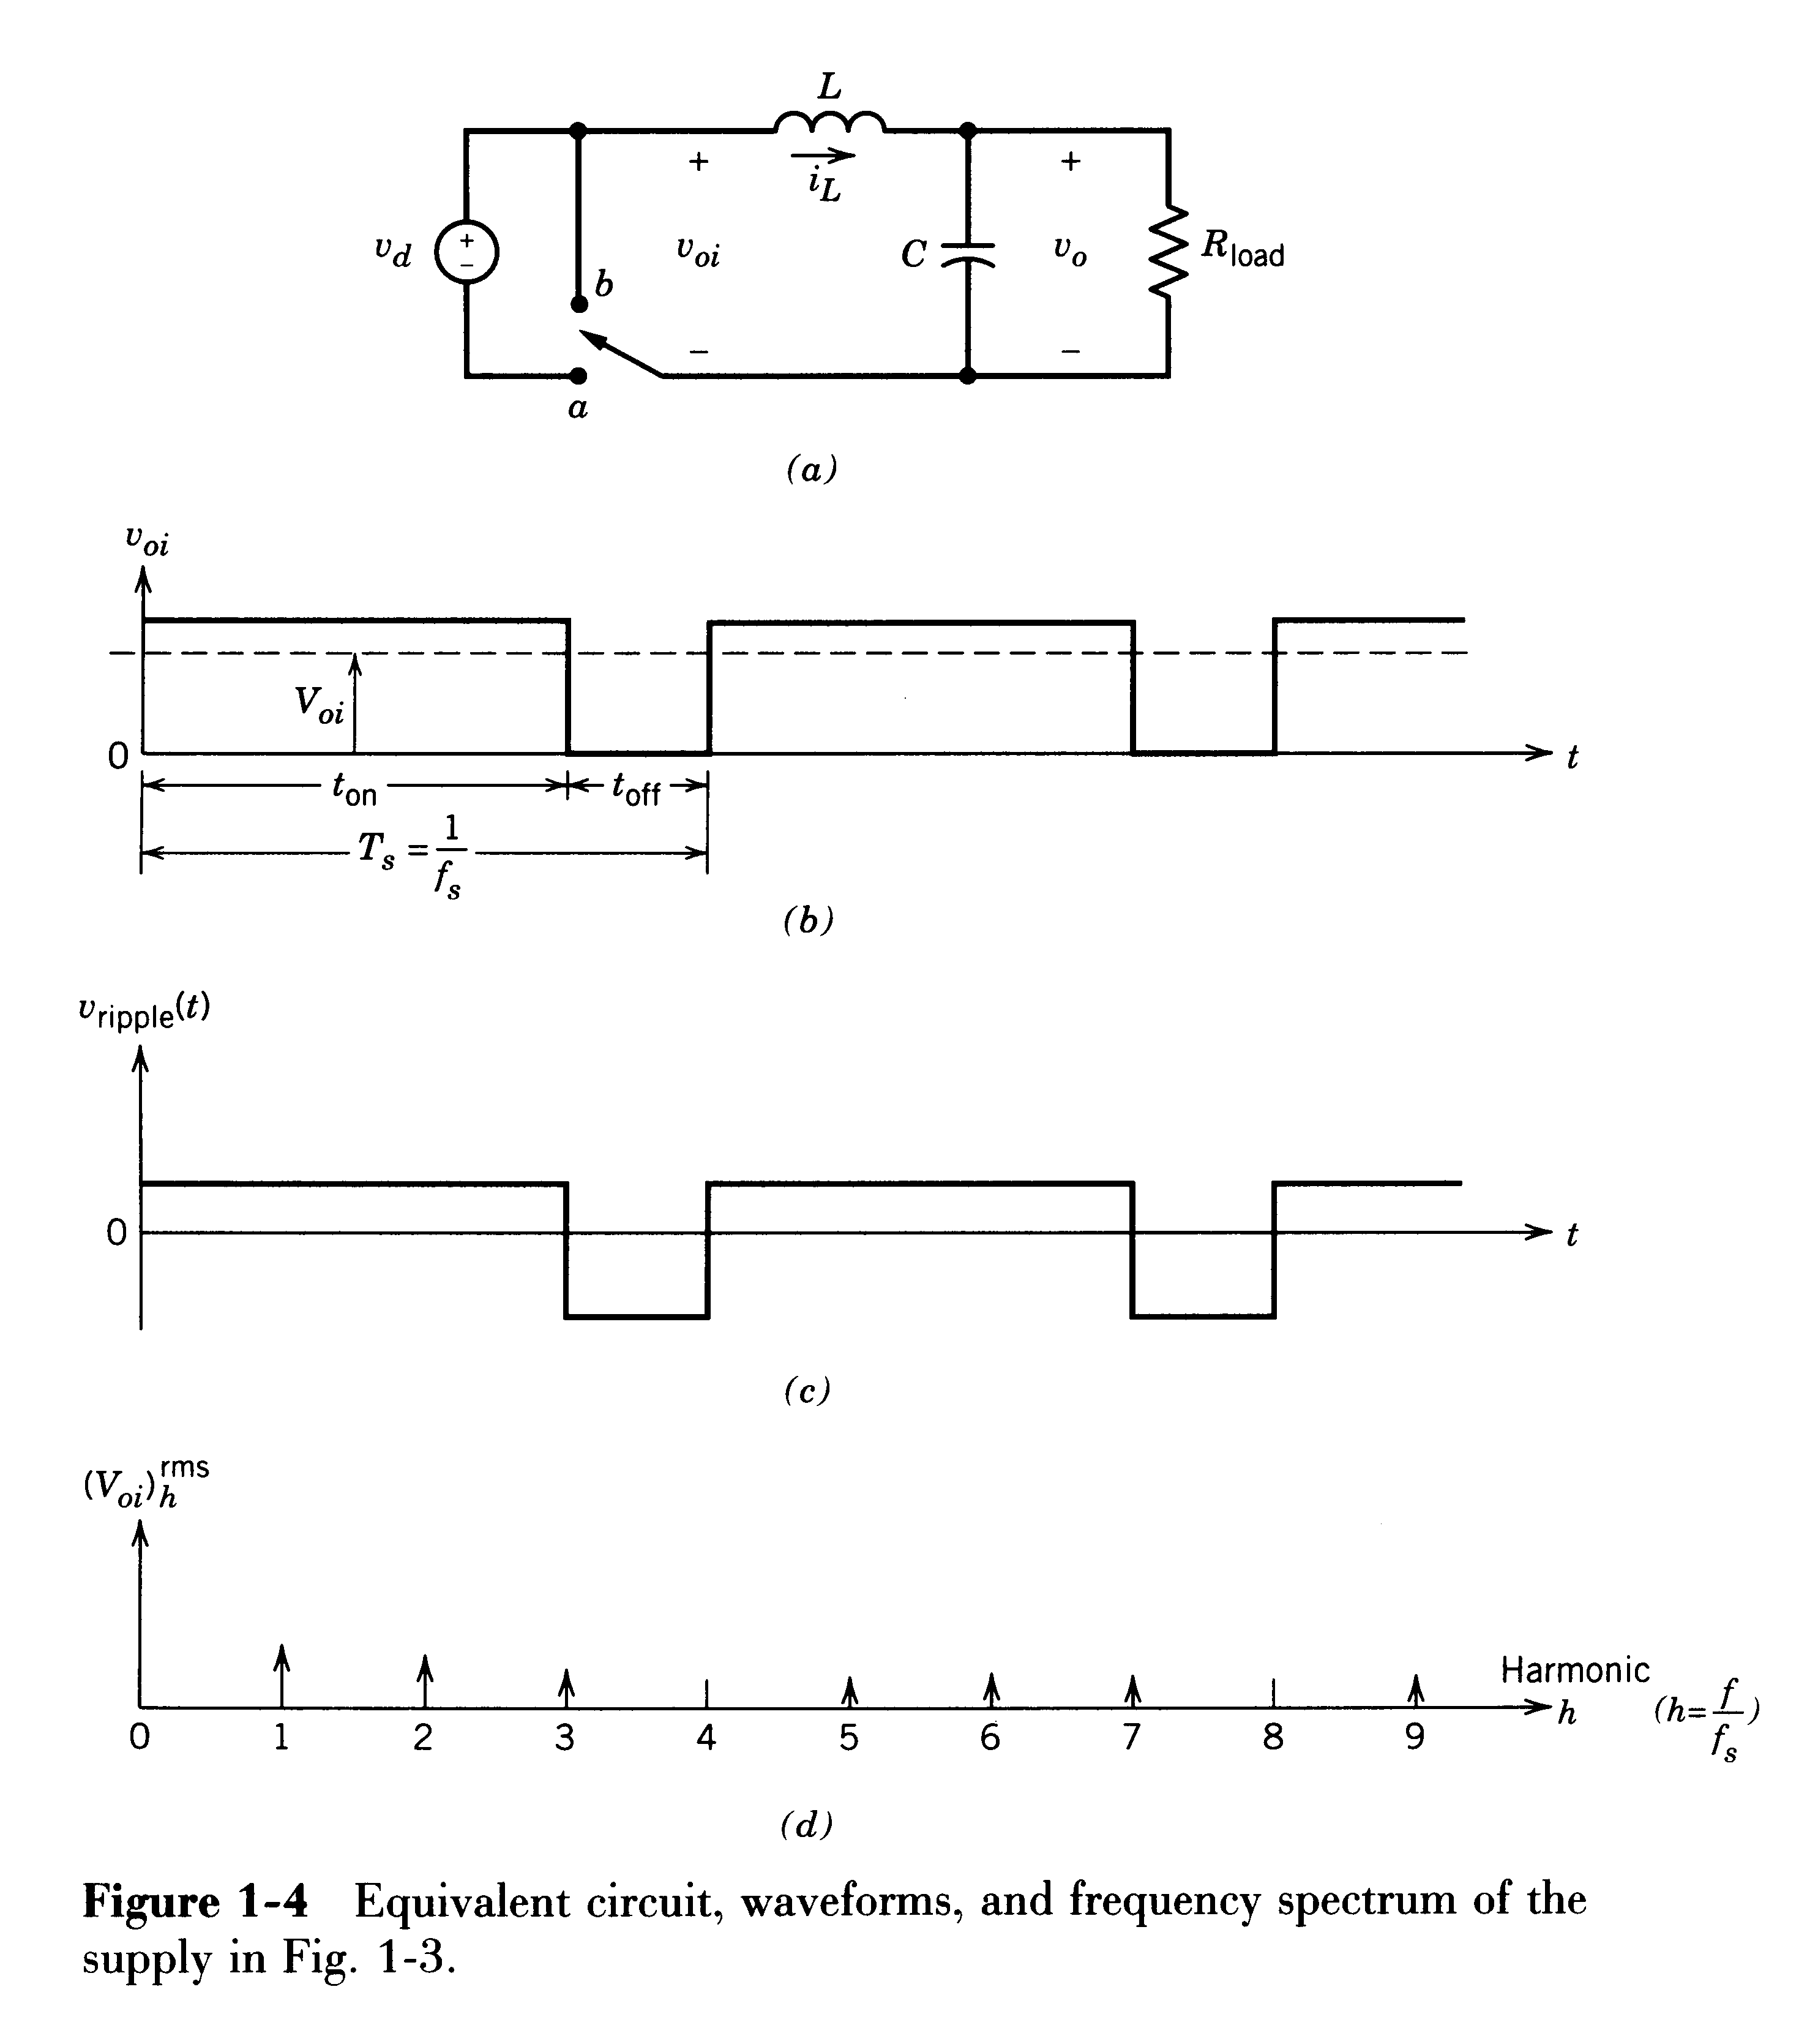
Basic Principle of Switch-Mode Synthesis
Fig. 1-4
Transistor as a switch
Constant switching frequency
pulse width controls the average
L-C filters the ripple
High Efficiency

Slide 14


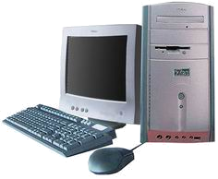

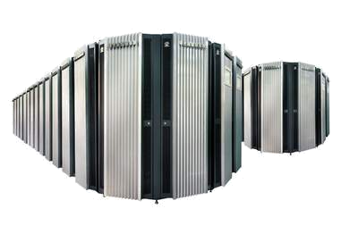
1-3 Applications of Power Electronics☆
1-3-1 Powering the Information Technology
server
computer
Telecommunication

Slide 15
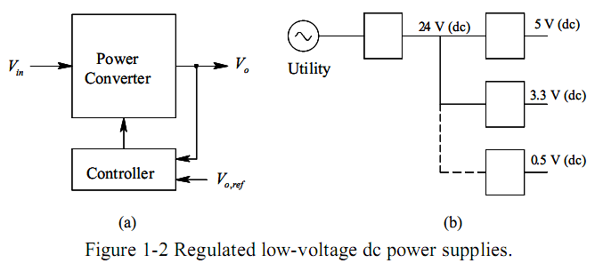
24V for PCs input voltage
5V, 3.3V, 0.5V for inner large scale integration and higher speed logic circuitry.

Slide 16
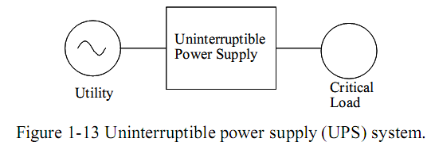
1-3-2 Uninterruptible Power Supplies
Computer
Communication equipment
Consumer electronics

Slide 17
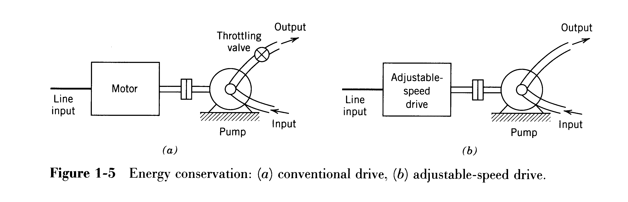
1-3-3 Energy Conservation
Electric Motor Driven systems
H
Conventional drive wastes energy across the throttling valve(节流阀) to adjust flow rate.
Using power electronics, motor-pump speed is adjusted efficiently to deliver the required flow rate.
R₂
R₁
H₁
n₁
H₂
n₂
Q
Q₂
Q₁

Slide 18
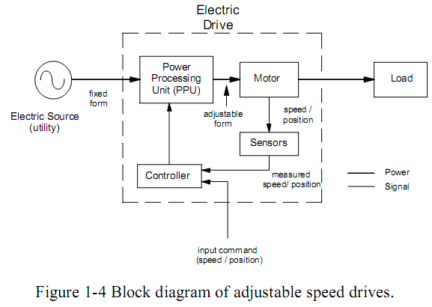
1-3-4 Process control and factory automation
Robotics and flexible production needed precise
Speed and position control
Provide:
adjustable magnitude dc voltage to dc motor
Sinusoidal ac voltages with adjustable amplitude and frequency to ac motor

Slide 19
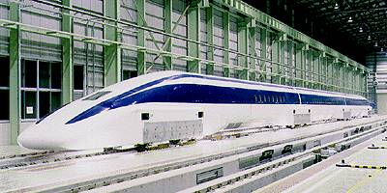
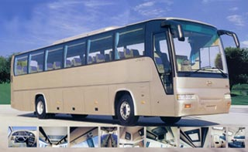
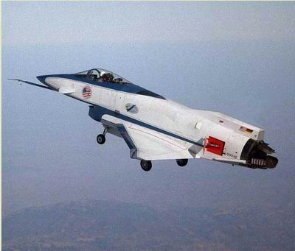
1-3-5 Transportation
adjustable speed electric drives
• Electric vehicles and Hybrid electric vehicles (EVs and HEVs)
• light rail
• all-electric ships
• drive-by-wire automobiles.

Slide 20
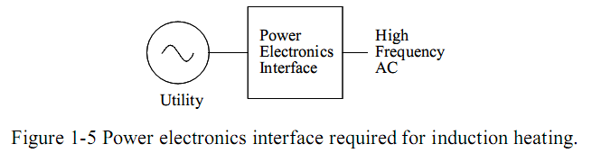
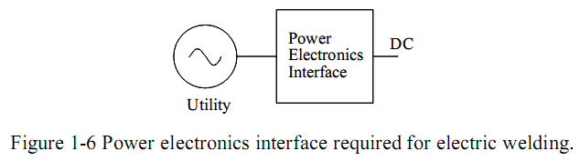
1-3-6 Electro-technical applications
Induction Heating
Electric Welding

Slide 21
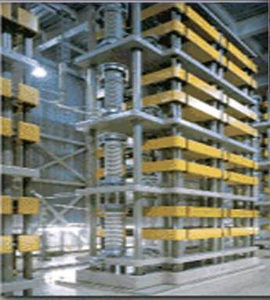
1-3-7 Utility Applications
High-voltage dc transmission (HVDC)
Flexible ac transmission (FACTS)
Static var compensation & harmonics suppression: TCR, TSC, SVG, APF
Power quality control

Slide 22
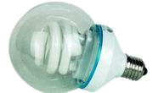
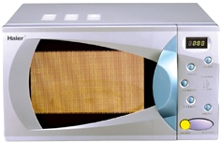


1-3-8 Lighting, Heating, Air conditioning,
Cooking, Cleaning

Slide 23
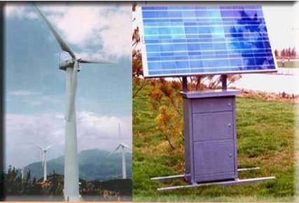
1-3-9 Renewable Energy
Photovoltaic Systems

Slide 24
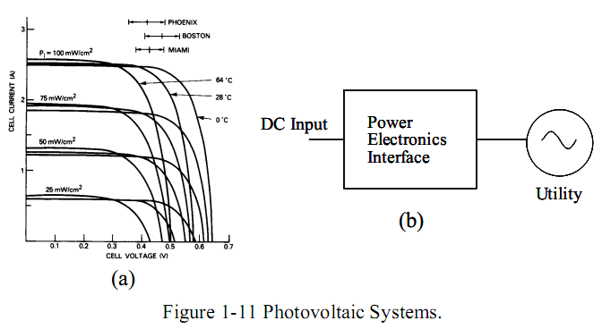
Photovoltaic Systems
Solar cells produce dc, power electronics interface transfer power to the utility system(用户系统).

Slide 25
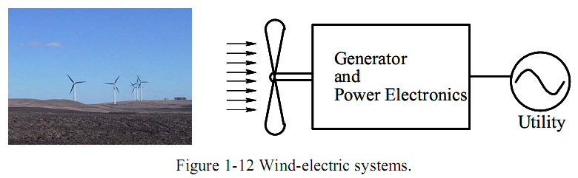
Wind-Electric Systems

Slide 26
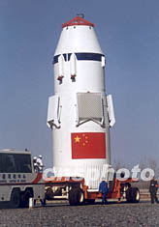
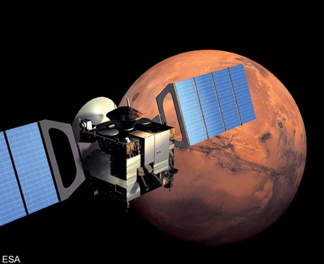
1-3-10 Strategic Space and Defense Applications

Slide 27
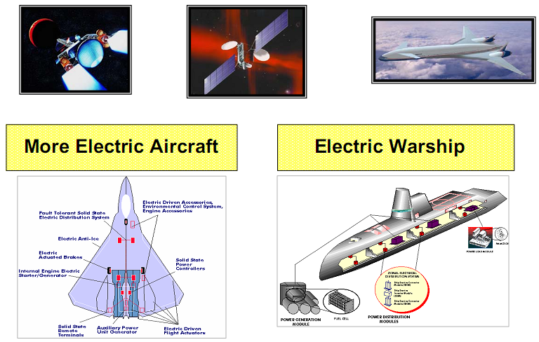
Strategic Space and Defense Applications

Slide 28
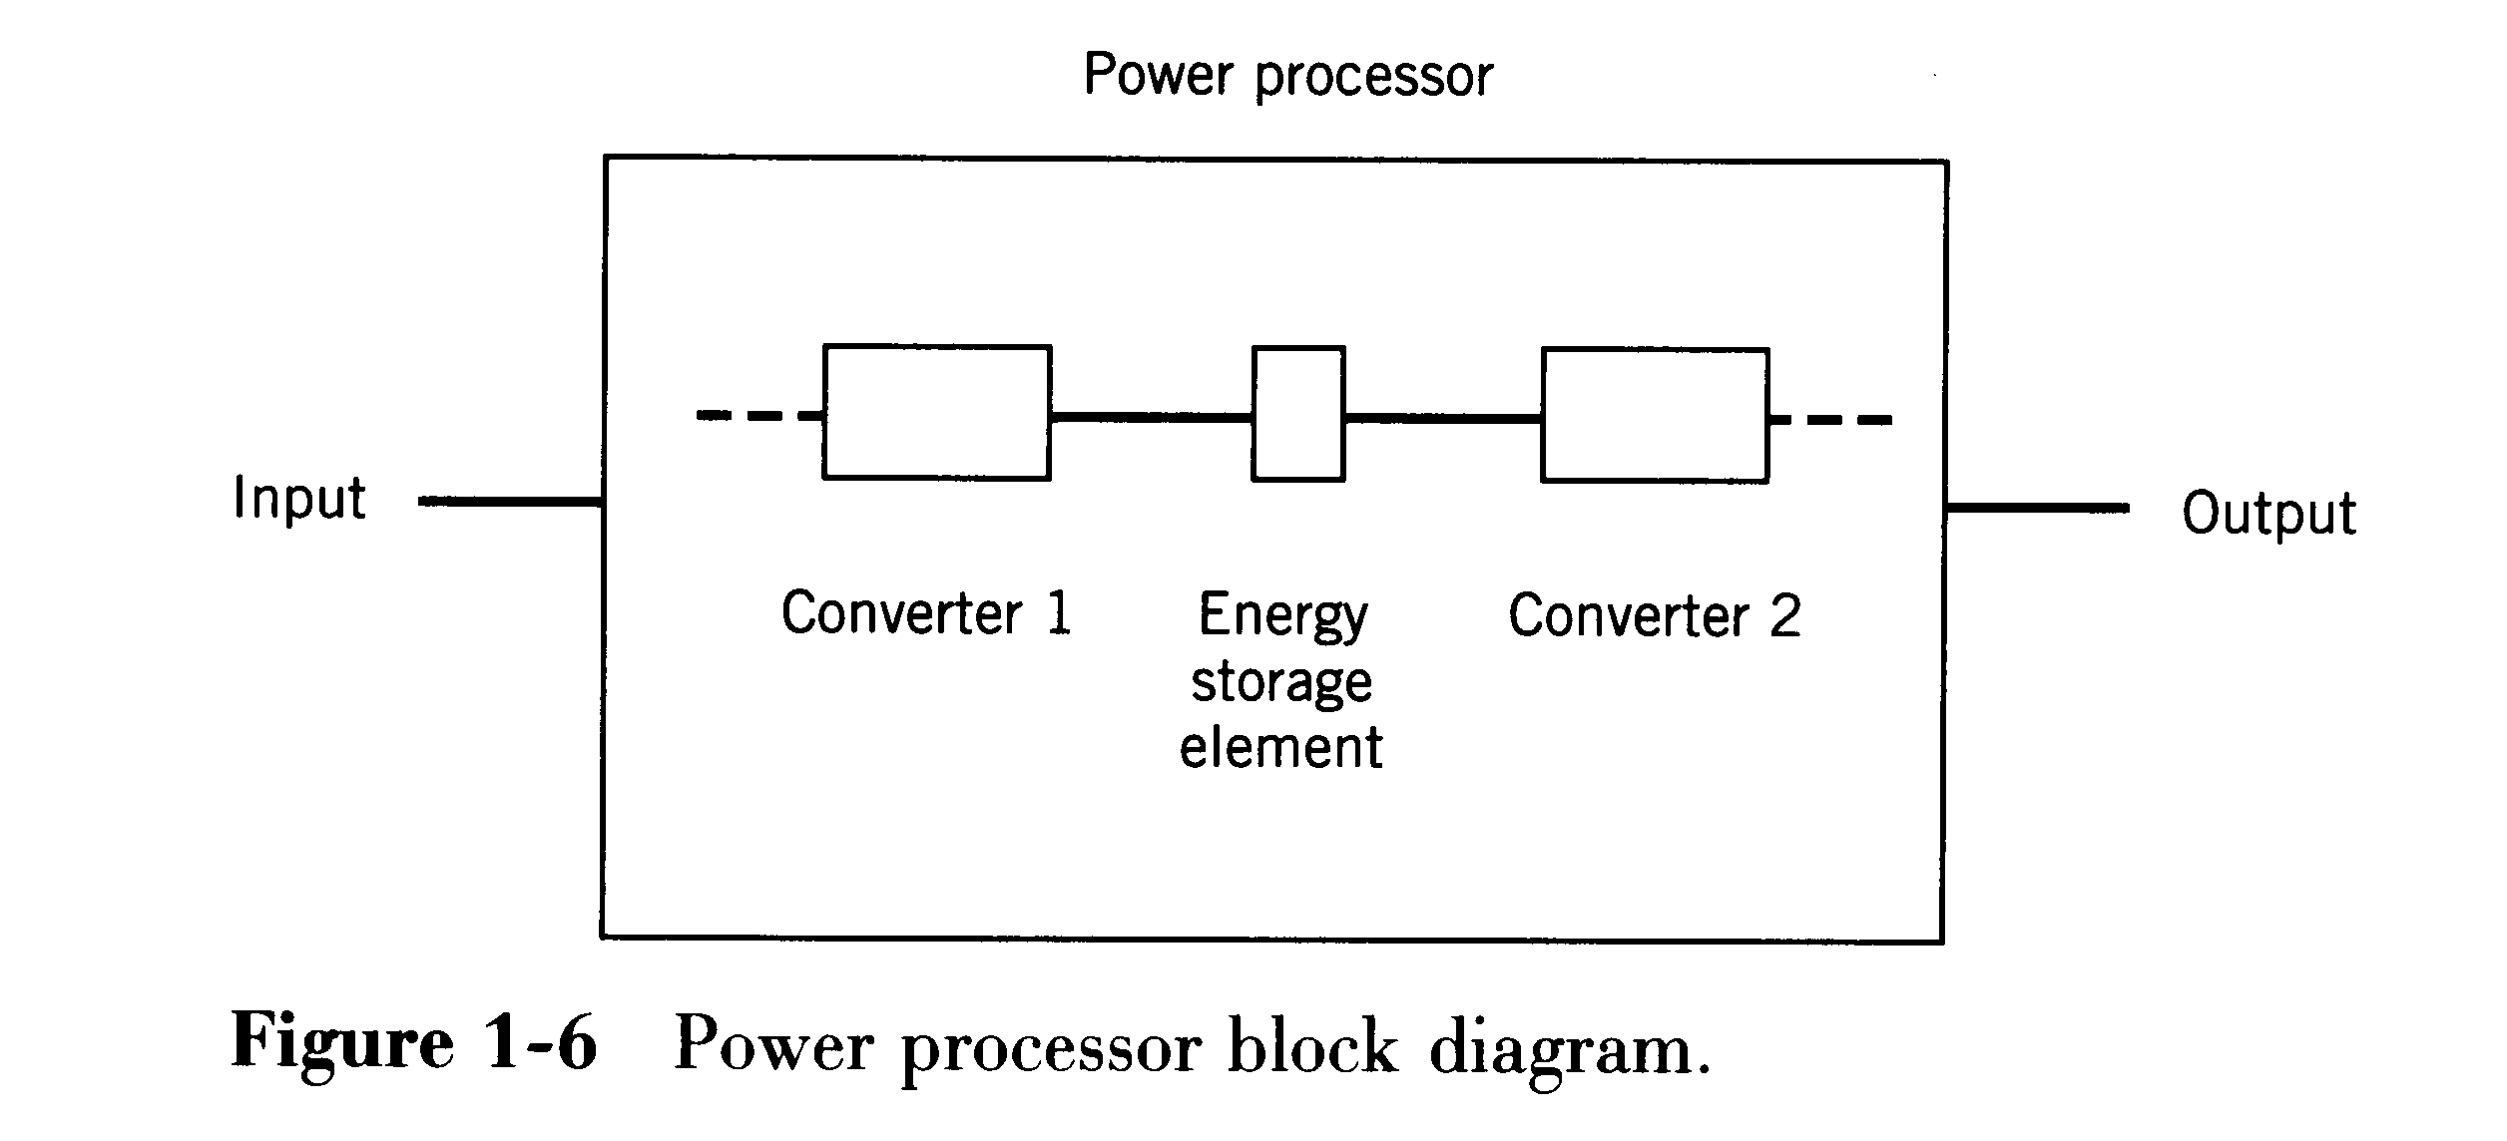
1-4 Classification of Power Processors and Converters
1-4-1 Power Processors
The power processor usually consist of more than one power conversion. Most practical topologies require an energy storage element, which also decouples the input and the output side converters.

Slide 29
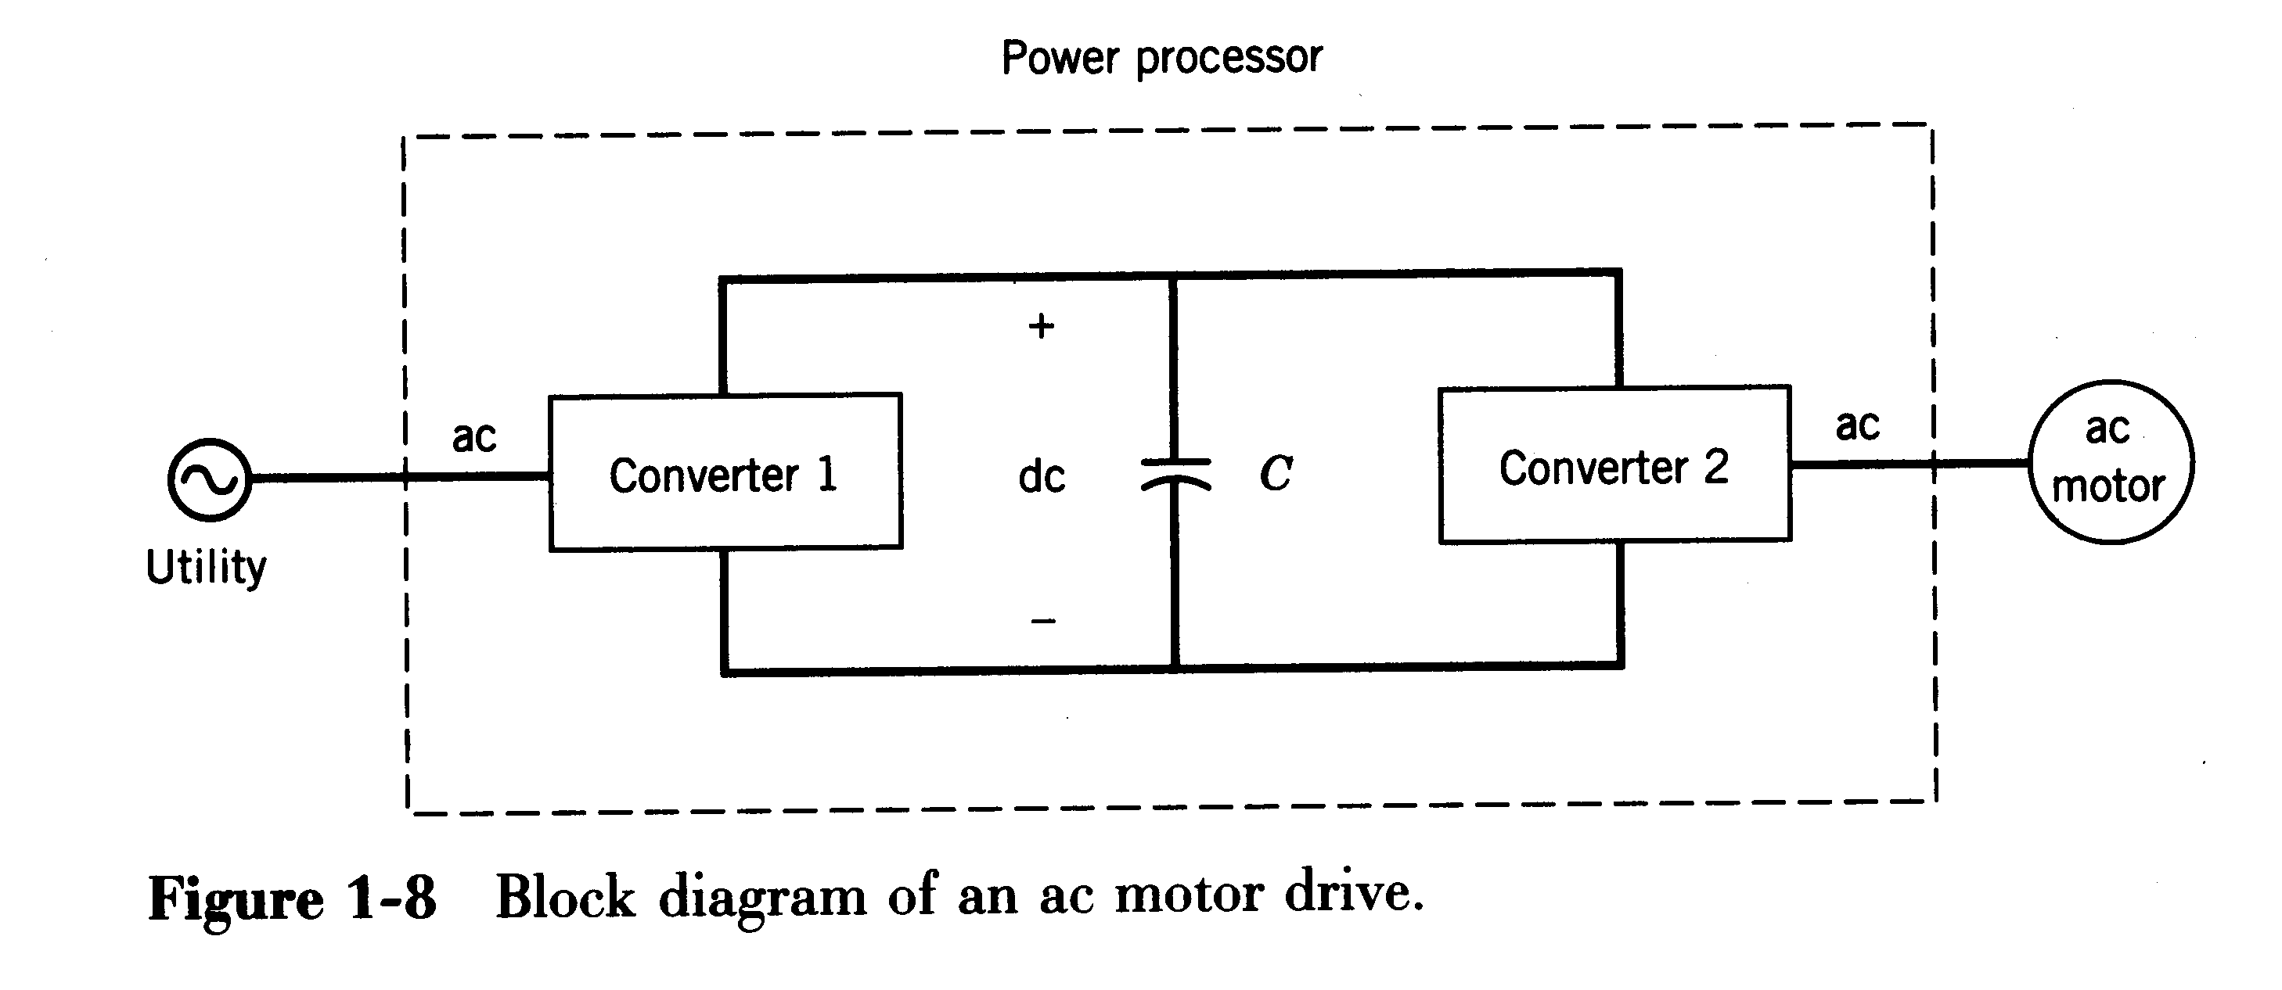
Example：AC Motor Drive
Converter 1 rectifies line-frequency ac into dc
Capacitor acts as a filter; stores energy; decouples
Converter 2 synthesizes adjustable -frequency ac to motor

Slide 30
In most power processors, the input is from the electric utility source. The output may have any of the following forms:
1. DC
Regulated (constant) magnitude，如开关电源
(b) Adjustable magnitude，如直流调速器
2. AC
Constant frequency, adjustable magnitude，如交流电源
(b) Adjustable frequency and adjustable magnitude，如交流调速器（变频器、伺服控制器）

Slide 31
1-4-2 Classification of power converters ☆
According to average power flow direction, converters can be divide into the follow categories:
Electric
Power
Converter
Power
input
Control input
Power
output
(1) Ac to dc----rectify, rectifier（整流器）
(2) Dc to dc----chop, chopper（斩波器）
(3) Dc to ac----invert, inverter（逆变器）
(4) Ac to ac----Fixed frequency : AC controller（交流电力控制器）
Variable frequency: Cycloconverter（周波变换器） or ac-ac frequency converter（交—交变频器）

Slide 32
According to how the devices within the converters are switched, there are three possibilities:
(1) Line frequency (naturally commutated) converters（工频变换器）
(2) Switched (forced-commutated) converters（开关变换器）
(3) Resonant and quasi-resonant converters（谐振变换器）

Slide 33
1-5 Interdisciplinary nature of power electronics☆
Electronics
Power
Devices,circuits
Static & rotating power equipment
Power Electronics
Continuous, discrete Control
Power electronics is the interface between
electronics and power.

Slide 34
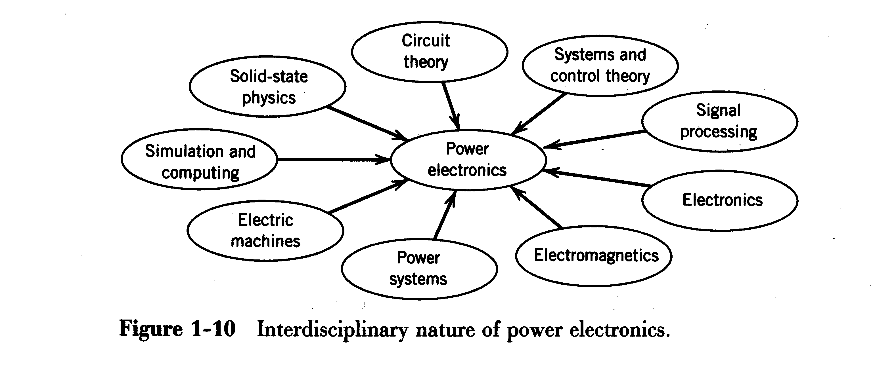
Relation with multiple disciplines
Power electronics is currently the most active discipline in electric power engineering.

Slide 35
1-6 About the text
1-6 About the Text
Reference
1 《POWER ELECTRONICS – CIRCUITS, DEVICES, AND APPLICATIONS》
MUHAMMAD H. RASHID, 北邮出版社 2007
2 《First Course on POWER ELECTRONICS》
NED MOHAN, MNPERE 2005

Slide 36
1-6 About the text
Textbook
«Power electronics: converter, applications, and Design», 3rd edition.
Authors: N. Mohan, T. M. Undeland, W. P. Robbins.
Published by John Wiley & Sons, New York, 2003, Higher Education Press, Beijing, China, 2004
This book is divided into seven parts, thirty chapter.

Slide 37
1-6 About the text
Part 1 (Chapter 1~4) presents an introduction, a brief review of basic concepts and devices, and computer simulations of power electronics system.——基础知识
Chapter 1 Power Electronic Systems
Chapter 2 Overview of Power Semiconductor devices
Chapter 3 Review of Basic Electrical and Magnetic Circuit Concepts
Chapter 4 Computer Simulation of Power Electronic Converters and System

Slide 38
1-6 About the text
Part 2 (Chapter 5~9) describes power electronic converters in a generic manner.——通用变换器
Chapter 5 Line-Frequency Diode Rectifiers: Line-Frequency ac →Uncontrolled dc
Chapter 6 Line-Frequency Phase-Controlled Rectifiers and Inverters: Line-Frequency ac ←→Controlled dc
Chapter 7 dc-dc Switch-Mode Converters
Chapter 8 Switch-Mode dc-ac Inverters: dc→Sinusoidal ac
Chapter 9 Resonant Converters: Zero-Voltage and/or Zero-Current Converter
Chapter 31 AC to AC Converters( see chapter 11 and chapter 12 in reference 1 )

Slide 39
1-6 About the text
Part 3 (Chapter 10~11) deals with power supplies.——电源
Chapter 10 Switching dc Power Supplies
Chapter 11 Power Conditioners and Uninterruptible Power
Part 4 (Chapter 12~15) describes motor driver applications.——电机驱动方面的应用
Chapter 12 Introduction to Motor Drives
Chapter 13 dc motor Drives
Chapter 14 Induction Motor drives
Chapter 15 Synchronous Motor Drives

Slide 40
1-6 About the text
Part 5 (Chapter 16~18) deals with other applications.——其它方面的应用
Chapter 16 Residential and Industrial Applications
Chapter 17 Electric Utility Applications
Chapter 18 Optimizing the Utility Interface with power electronic Systems
Part 6 (Chapter 19~26) discussed power semiconductor devices.——半导体器件
Chapter 20 Power Diodes
Chapter 22 Power MOSFETs
Chapter 23 Thyristors
Chapter 25 Insulated Gate Bipolar Transistors

Slide 41
1-6 About the text
Part 7 (Chapter 27~30) presents the practical design considerations of power electronic system.——电力电子系统设计相关技术
Chapter 27 Snubber Circuit
Chapter 28 Gate and base Drive Circuits
Chapter 29 Component Temperature Control and Heat Sinks
Chapter 30 Design of Magnetic components (see chapter 7 and chapter 9 in reference 2)

Slide 42
1-7 About the Course
Arrangement of teaching:
dc-dc converter → dc-ac converter→
ac-dc converter → ac-ac converter→
Drive Circuits and Snubber Circuits
Lectures: 48 hours
Labs: 8 hours, 3 projects
考核形式和成绩评定：平时成绩40% + 期末考试60%
平时成绩=小测+实验成绩+考勤和课堂表现成绩。
小测：30分，分3次测试，每次10分，每次测试时间50分钟，闭卷
实验：10分，共4个实验，每个实验2.5分
考勤和课堂表现
期末考试60分，考试方式：闭卷

Slide 43
小资料
与电力电子技术有关的国内主要学术组织
1、中国电工技术学会
（CES——China Electrotechnical Society）
网址：http://www.ces.org.cn
期刊：电工技术学报
（Transactions of China Electrotechnical Society）
学术会议：国际电力电子及运动控制大会
（International Power Electronics and Motion Control Conference）

Slide 44
2、电力电子学会
（Power Electronics Society）
网址：http://www.pes.org.cn
期刊：电力电子技术（Power Electronics）
学术会议：中国电工技术学会电力电子学会年会
3、电控装置与系统专业委员会
期刊：电气传动（Electric Drive）
学术会议：全国电气自动化与电控系统学术年会

Slide 45
4、中国电机工程学会
（EACS——Chinese Society of Electrical Engineering）
网址：http://www.csee.org.cn
期刊：中国电机工程学报
（Proceedings of the Chinese Society for Electrical Engineering ）
5、中国电源学会（China Power Supply Society）
网址：http://www.dianyuan.com/cpss/
学术会议：中国电源学会学术年会

Slide 46
Problem
1-1 In the power processor of Fig. 1-1, the energy efficiency is 95%. The output to the three-phase is as follows: 200V line-to-line (rms) sinusoidal voltages at 52Hz and line current of 10A at a power factor of 0.8 (lagging). The input to the power processor is a single-phase utility voltage of 230V at 60 Hz. The input power is drawn at a unity power factor. Calculate the input current and the input power.
Power input
Power
Converter
Power output
Load
Source
v_{i}
i_{i}
i_{o}
v_{o}
Feedback/
Feed forward
Fig. 1-1
Controller
Reference

Slide 47
Problem
1-2 Consider a linear regulated dc power supply (Fig. 1-2a). The instantaneous input voltage corresponds to the lowest waveform in Fig. 1-2b, where V_{d,min}=20V and V_{d,max}=30V. Approximate this waveform by a triangular wave consisting of two linear segments between the above two values. Let V_{o}=15V and assume that the output load is constant. Calculate the energy efficiency in this part of the power supply due to losses in the transistor.
Fig. 1-2

